Slide 1

Into Another Dimension: Developing a Simulation of 4D Space by Implementing 4D Rigid Body Dynamics and Ray Marching
By Epifanio Torres ‘22
Advised by Dr. Szymon Rusinkiewicz
Notes:
Alrighty, so I’ll just jump right into it. The name of my project is “Into Another Dimension: Developing a Simulation of 4D Space by Implementing 4D Rigid Body Dynamics and Ray Marching.”

Slide 2


Motivation
Higher-Dimensional Spaces:
Hard to Understand
Hard to Visualize
Opportunities for:
Conceptual Tools
Games & Entertainment
Notes:
To start off, I would like to briefly describe some of the motivations for this project. Since we humans experience the world around us as a three-dimensional space, understanding and visualizing higher dimensional spaces (such as 4D space) tends to be difficult for us. This presents unique opportunities for developing conceptual tools that help us better understand higher-dimensional spaces, as well as opportunities for making programs that incorporate higher-dimensional spaces in games and other forms of digital entertainment. In recent years, a few projects have been made that seek to take advantage of these opportunities.

Slide 3
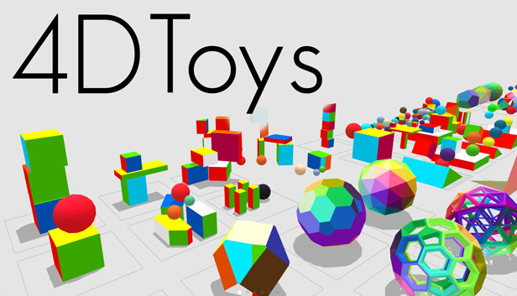
Related Projects (1)
4D Toys by Marc ten Bosch
Notes:
One such project is a program named 4D Toys by Marc ten Bosch. In this program, users are encouraged to experiment with different 4D objects to learn about how they move and interact with one another.

Slide 4
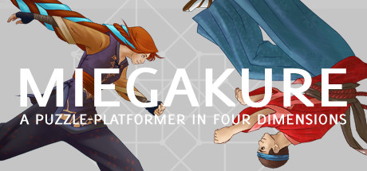
Related Projects (2)
Miegakure by Marc ten Bosch
Notes:
Another project is a game named Miegakure (also by Marc ten Bosch). In this game, users are tasked with exploring a 4D space to solve different puzzles and challenges.

Slide 5
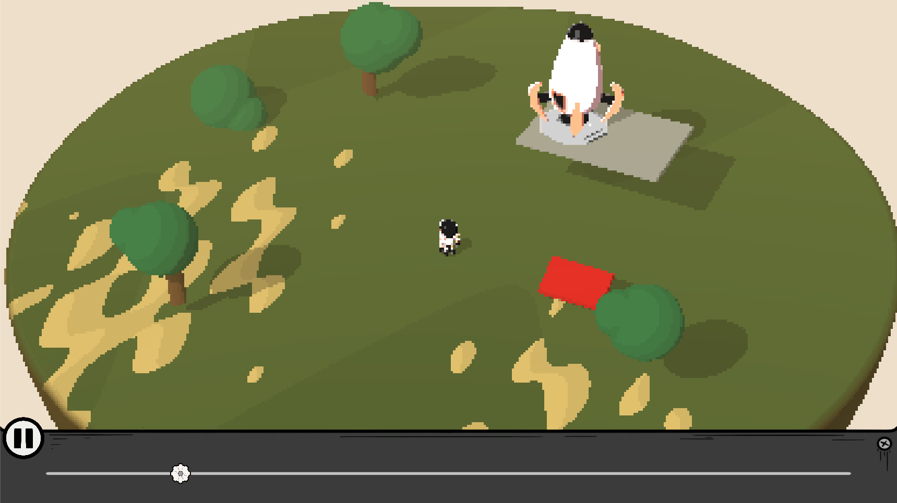
Related Projects (3)
4D Explorer by Jelle Vermandere
Notes:
Similar to Miegakure is a game named 4D Explorer by Jelle Vermandere. In this short game, users play as an astronaut who must navigate a 4D space to reach their spaceship.

Slide 6
Approach
Limitations of These Projects
Providing Explanations & Code:
4D Rigid Body Dynamics
4D Rendering Pipeline
Notes:
These three projects do an excellent job of simulating 4D spaces and allowing users to interact with them. Nevertheless, these projects don’t provide a very detailed description of their implementation details, making them difficult to use as a starting point for other similar projects. As a result, this project seeks to build a 4D simulation from the ground up and provide detailed explanations of its implementation. In particular, this project’s 4D simulation comes equipped with both 4D rigid body dynamics and a 4D rendering pipeline.

Slide 7
Implementation Summary
1. Defining the Underlying Math
2. Rendering the 4D Space
3. Representing the 4D Primitives
4. Detecting 4D Collisions
5. Resolving 4D Collisions
Notes:
Broadly, my project can be broken down into 5 main components. The first component corresponds to the underlying mathematical principles that were used for this project’s calculations. The second is the project’s rendering pipeline. The third is the representation of the different 4D primitives that this project incorporates. The fourth corresponds to the algorithms for detecting collisions between these 4D primitives. And the fifth corresponds to the algorithms for resolving the collisions.

Slide 8
Using Geometric Algebra
Limitations of Traditional Vector Algebra
Geometric Algebra Defines:
Bivectors (for 2D Planes)
Rotors (for Rotations)
Other Multivectors & Operations
Notes:
Whereas 2D planes in 3D space can be described with vectors in 3D space, they cannot be described with vectors in 4D space because planes 4D space do not have a single normal vector. This means that the cross product cannot be used and that rotations (which are transformations about planes) cannot be described with axis vectors. This poses a significant challenge to using traditional vector algebra for simulating 4D spaces.
As a result, this project uses geometric algebra instead because geometric algebra defines a variety of objects that generalize easily to 4D space. For example, geometric algebra defines an object known as a bivector which can be used to directly describe an oriented plane (like how a vector describes an oriented line). Additionally, geometric algebra defines a special object known as a rotor which can be used to represent rotations in any space. Lastly, geometric algebra defines its own set of operations that generalize common operations in traditional vector algebra. All of this means that it is a great option for the underlying math for simulating 4D spaces.

Slide 9
4D Rendering Pipeline
Rendering 3D Projections of 4D Space:
3D View Frustum in 4D Space
Implementing Ray Marching:
Sphere Tracing Algorithm
Notes:
Now I would like to briefly describe the rendering pipeline of my project. Similar to the three related projects described earlier, this project visualizes 4D spaces by rendering 3D projections (or cross-sections) of them. This can be done by defining a perspective camera with a 3D view frustum, a 4D position, and a 4D orientation. Since the camera’s frustum defines the region of space that it renders, a 3D view frustum can only render 3D regions of 4D space. Nevertheless, since the camera has a 4D position and orientation, these 3D regions can be translated and rotated arbitrarily in the 4D space.
In order to render the objects in the space, this project implements ray marching. In particular, this project’s specific approach to ray marching is inspired by the sphere tracing algorithm, which allows objects to be defined implicitly with mathematical functions.

Slide 10
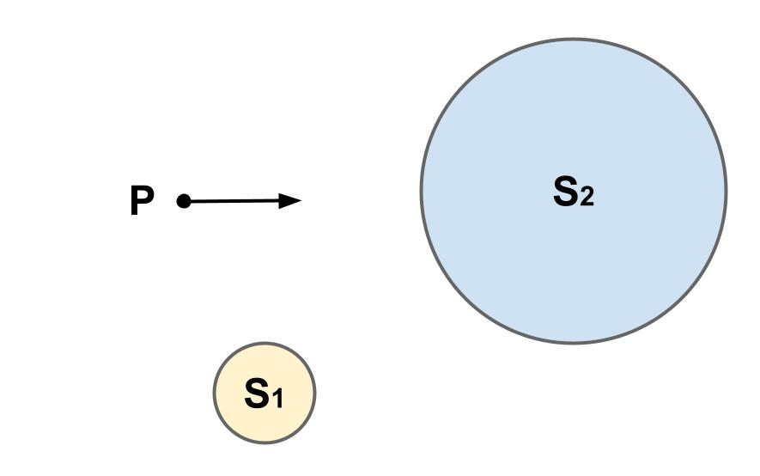
Sphere Tracing (1)
Notes:
The sphere tracing algorithm is an iterative algorithm that involves casting a ray along each pixel of the camera’s screen. Each ray starts at the camera’s origin and has a direction determined by the 3D view frustum. In the figure shown, the ray’s origin is point P and the ray’s direction is indicated by the solid arrow.

Slide 11
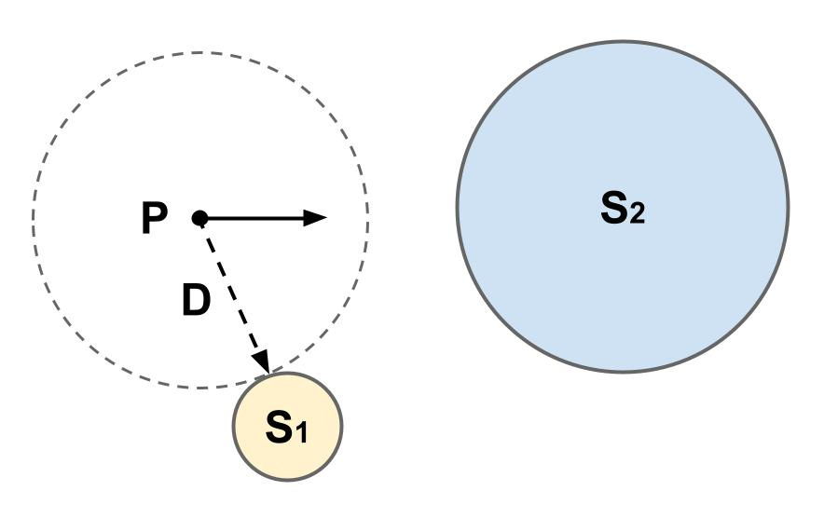
Sphere Tracing (2)
Notes:
The algorithm begins by calculating the distance from the ray’s origin to the closest object in the space. In this case, the ray’s origin is D units away from S1. Notably, since this is the distance from the nearest object, no other objects lie within a D unit radius from the ray’s origin.

Slide 12
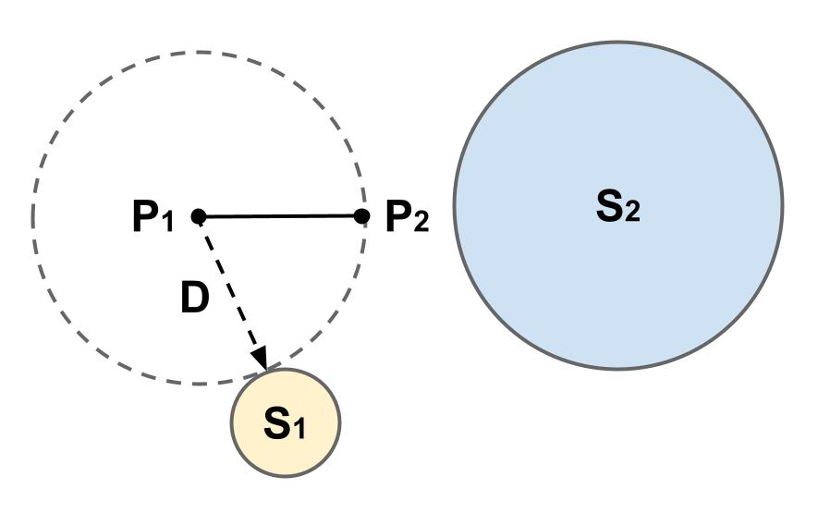
Sphere Tracing (3)
Notes:
As a result, the ray’s origin can be translated D units along its direction vector without intersecting an object. In this case, the ray’s new origin is P2.

Slide 13
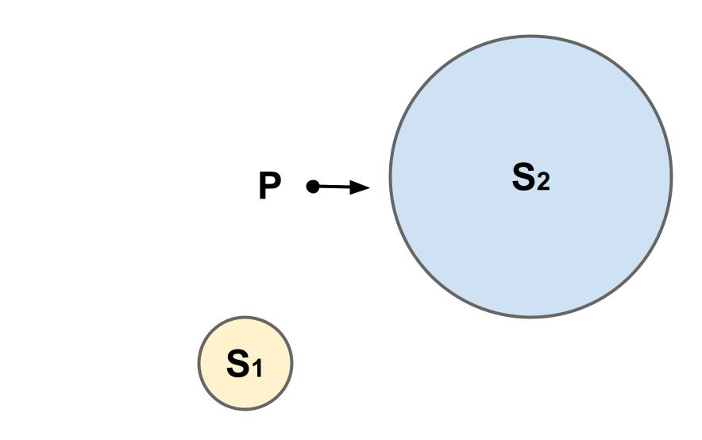
Sphere Tracing (4)
Notes:
The algorithm repeats with the ray’s new origin as the starting point. The ray’s direction remains the same.

Slide 14
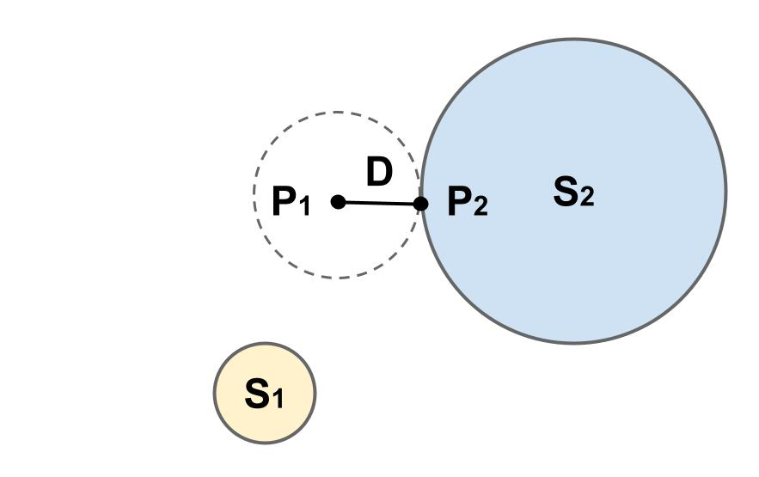
Sphere Tracing (5)
Notes:
The algorithm then calculates the distance to the nearest object again. In this case, the ray’s origin P1 is D units away from S2. The ray’s origin is marched D units along its direction vector, becoming P2. Since P2 is on the surface of S2, the algorithm can terminate. It then returns the final position of the ray’s origin and the color of the nearest object that it intersected with.

Slide 15
Hyperspheres
4D Equivalent of a 3D Sphere
Has a Radius and a Center Point
Notes:
Now we can briefly talk about the 4D primitives that were included in this project. The first is a 4D hypersphere, which is the 4D equivalent of a 3D sphere. Like a 3D sphere, hyperspheres are defined as the set of points that are a fixed radius away from a center point.

Slide 16
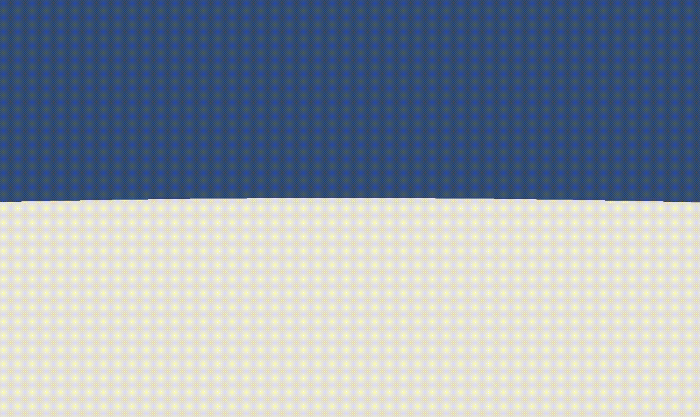
3D Projections of a Hypersphere
Notes:
This GIF shows what a 3D projection of a hypersphere looks like as the 3D projection is translated along the w-axis.

Slide 17
Hypercapsules
4D Equivalent of a 3D capsule:
Sweeping Hypersphere along Line Segment
Has a Radius and a Height
Notes:
Next is a hypercapsule. A hypercapsule is the 4D equivalent of a 3D capsule. Similar to how a 3D capsule can be generated by sweeping a 3D sphere along a line segment, a hypercapsule can be generated by sweeping a 4D hypersphere along a line segment. Notably, each hypercapsule can be described with a radius and a height.

Slide 18
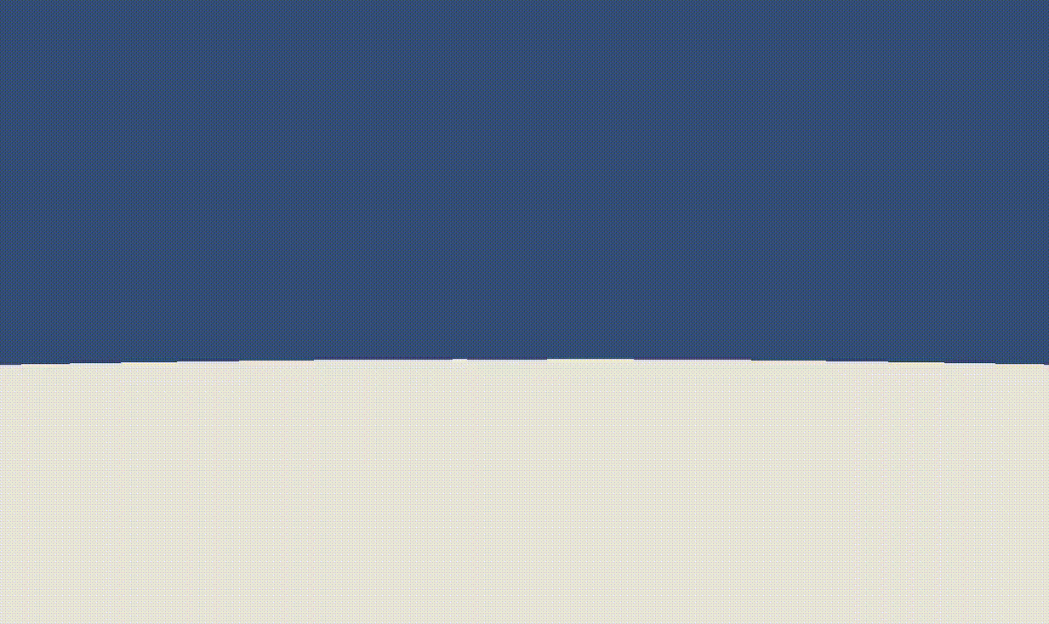
3D Projections of a Hypercapsule (1)
Notes:
This GIF shows what a 3D projection of a vertical hypercapsule looks like as the 3D projection is translated along the w-axis.

Slide 19
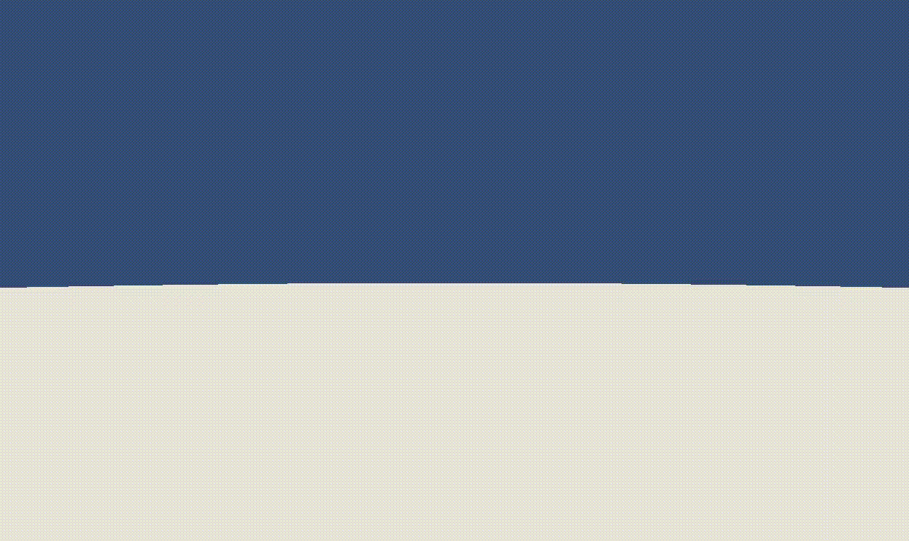
3D Projections of a Hypercapsule (2)
Rotated π/4 radians about the yw-plane
Notes:
This GIF shows 3D projections of a hypercapsule that is rotated pi over 4 radians about the yw-plane.

Slide 20
Hyperboxes
4D Equivalent of a 3D Box (or Cuboid):
Has Vertices, Edges, Faces, and 3-Cells
Has a Scale for Parallel Edges
Notes:
A hyperbox is the 4D equivalent of a 3D box (or cuboid). Like 3D boxes, hyperboxes have vertices, edges, and faces. Unlike 3D boxes, hyperboxes also have 3-cells (which correspond to 3D volumes). A hyperbox has 4 sets of parallel edges. Notably, all of the edges in a parallel set have the same length.

Slide 21
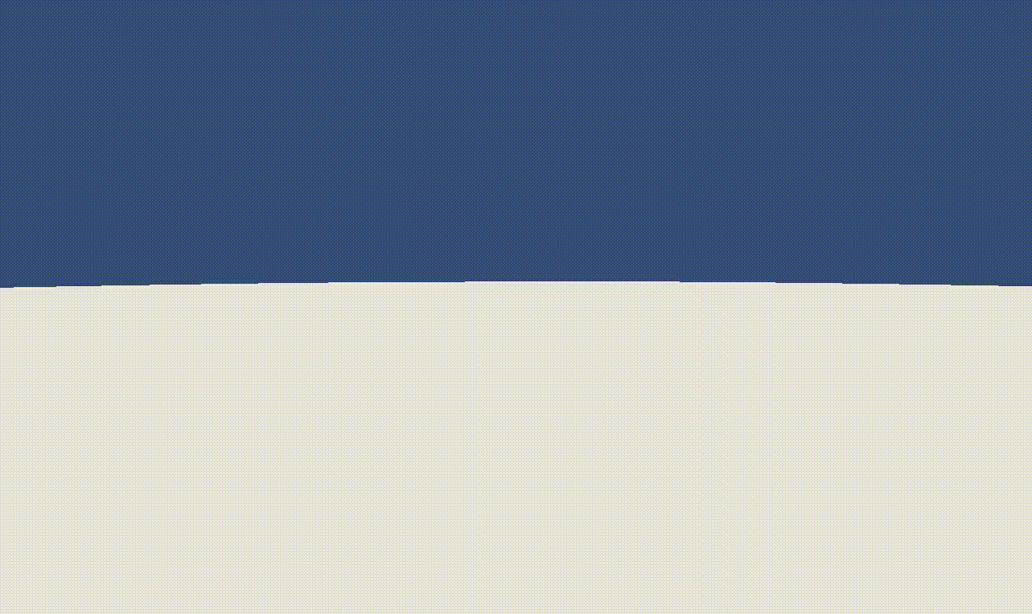
3D Projections of a Hyperbox (1)
Notes:
This GIF shows what a 3D projection of a hyperbox looks like as the 3D projection is translated along the w-axis.

Slide 22
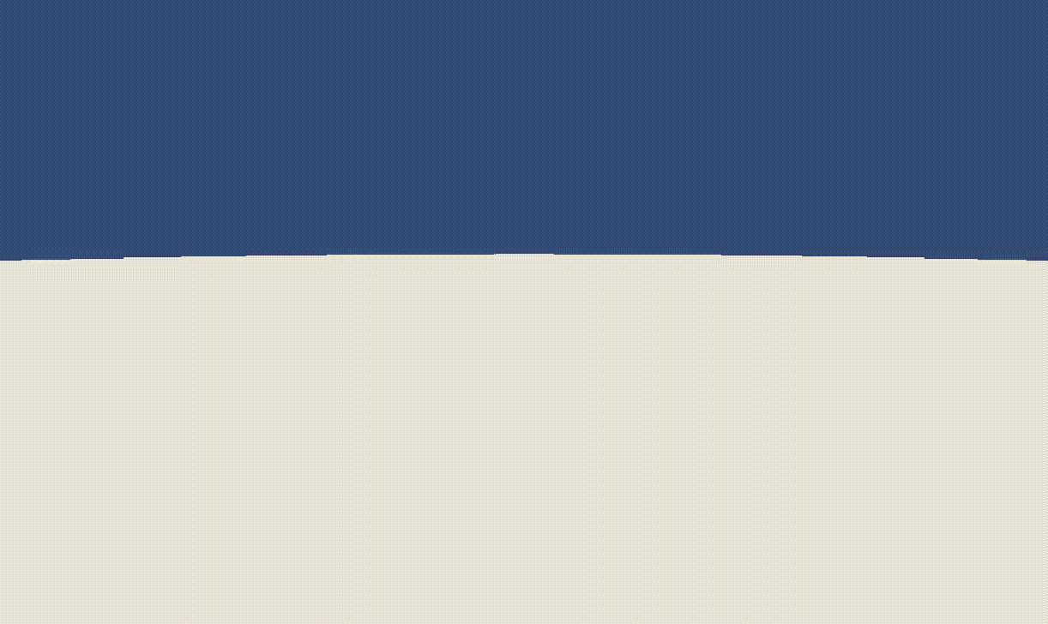
3D Projections of a Hyperbox (2)
Rotated π/4 radians about the yw-plane
Notes:
This GIF shows what a 3D projection of a hyperbox that is rotated pi over 4 radians about the yw-plane.

Slide 23
Hyperplanes
Equivalent of a 2D Plane in 3D Space:
Extends Infinitely in 3 Directions
Has a normal vector
Notes:
Last up are hyperplanes. In 4D space, hyperplanes are the equivalent of 2D planes in 3D space. Notably, in 4D space, hyperplanes are 3D solids that extend infinitely in 3 directions and have an infinite volume. Each hyperplane has a single normal vector.

Slide 24
4D Collision Detection
An Algorithm for Each Type of Pair
Record Info about Collisions:
Collision Normal
Contact Point
Separation
Notes:
Now that we’ve discussed the different primitives, we can briefly touch on detecting collisions between them. Notably, a different algorithm must be used for each type of pair of objects. For example, the algorithm for detecting collisions between two hyperboxes will be different from the algorithm for detecting collisions between two hyperspheres. Regardless of the details of the collision detection algorithms, for each collision, they should calculate and store the collision normal, contact point, and separation between the objects. These values are necessary for resolving the collisions.

Slide 25
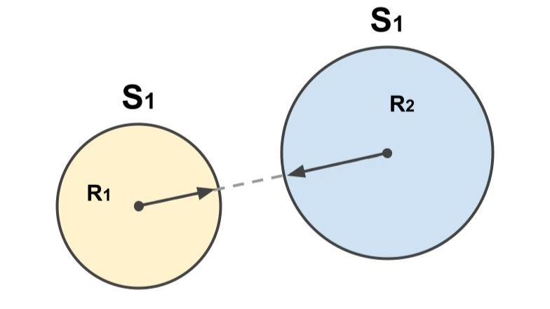
Example: Collision Detection Between Two Hyperspheres
Notes:
An example of one collision detection algorithm is the algorithm for two hyperspheres. This algorithm works by checking if the distance between two hyperspheres is greater than the sum of their radii.

Slide 26
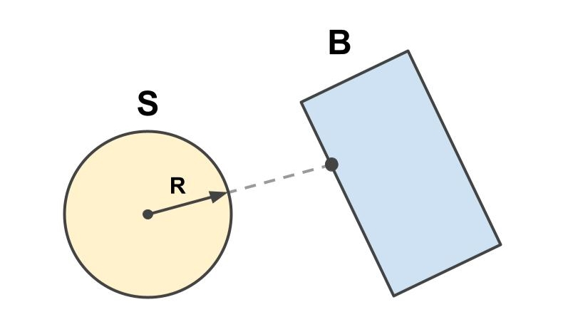
Example: Collision Detection Between a Hypersphere and Hyperbox
Notes:
Another example is the collision detection algorithm for a hypersphere and hyperbox. This algorithm works by finding the closest point on the hyperbox’s surface. If the distance between this point and the hypersphere’s center is less than the hypersphere’s radius, then the two objects are colliding.

Slide 27
4D Collision Resolution
Changing velocities with impulses:
Normal Impulses for Separation
Tangent Impulses for Friction
Sequential impulse Solver:
Accumulating Impulses
Impulse Caching
Impulse Clamping
Notes:
The final component of my project involves resolving collisions between each pair of colliding objects. Although different approaches exist for this, I decided to use an impulse-based approach. This involves applying normal impulses at contact points to separate objects and applying tangent impulses at contact points to simulate friction.
In particular, my impulse-based collision resolution algorithm draws heavily on Erin Catto’s sequential impulse solver approach. This is an iterative approach that involves calculating, applying, and accumulating impulses at each contact point multiple times during a single timestep. These approach works by caching (or storing) impulses at each contact point and clamping those impulses to ensure that they fall within an appropriate range of values.

Slide 28
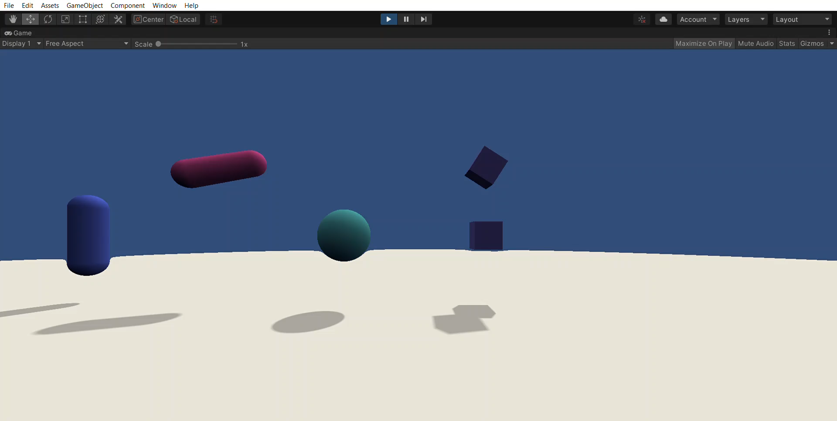
Collision Resolution Demo
w-axis position is 0

Slide 29
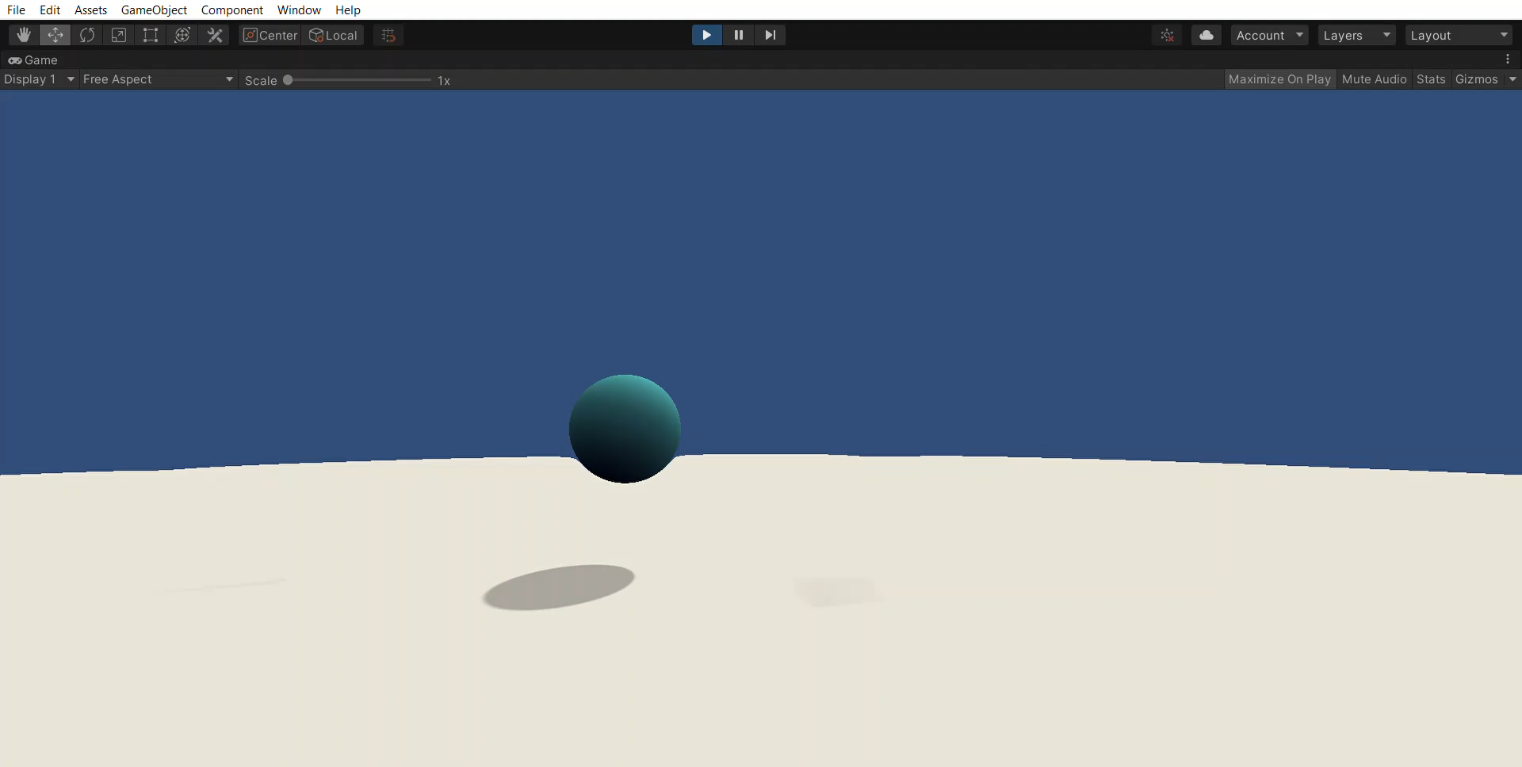
Collision Resolution Demo
w-axis position is 1.25

Slide 30
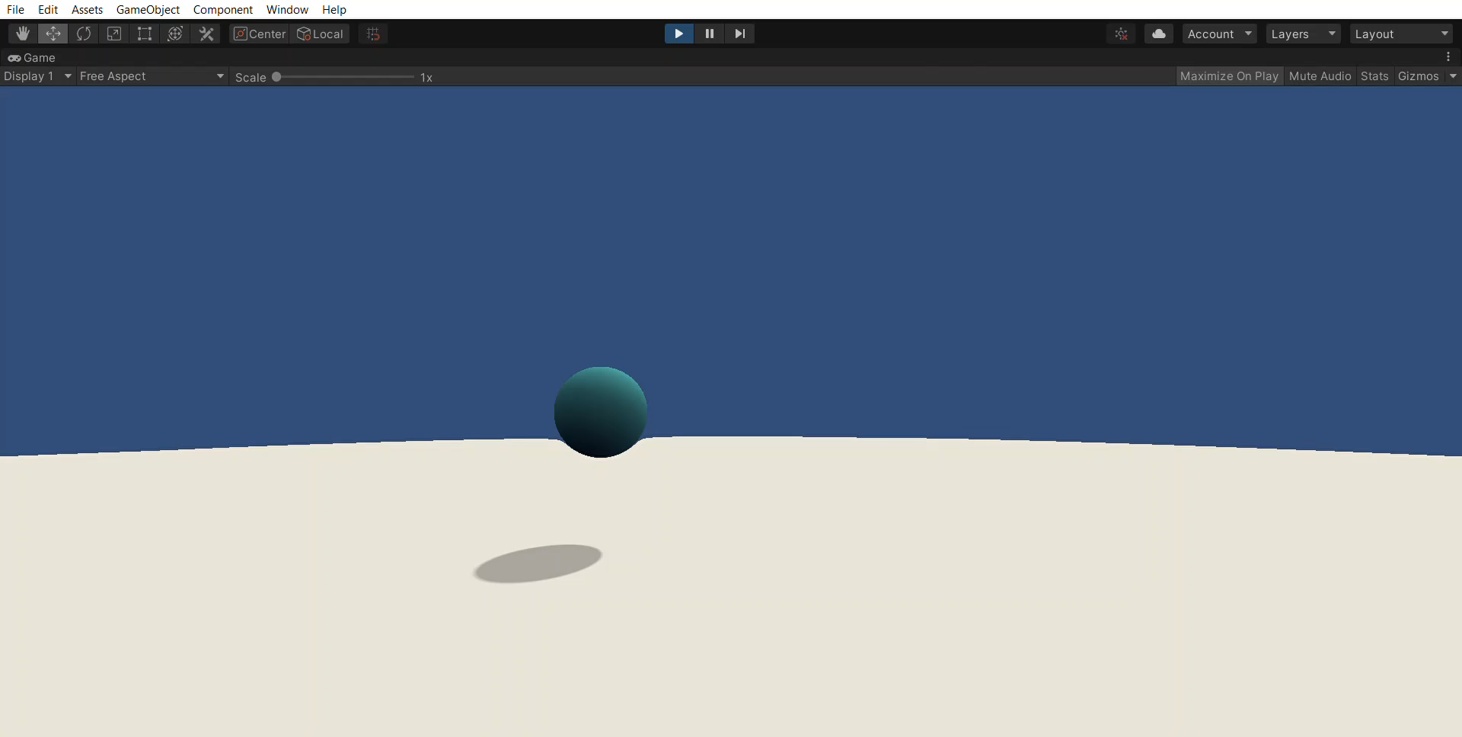
Collision Resolution Demo
w-axis position is 2

Slide 31
Future Work
Implementing Elastic Collisions
Making Player Movement & Interactions More Robust
Optimizing the Ray Marching Implementation
Notes:
One downside of the sequential impulse solver approach that my project uses is that it assumes that all collisions are inelastic. As a result, future work on this project could be down to incorporate elastic and partially elastic collisions as well.
Additionally, although this project does include very simple movement throughout the 4D space, more work can be done to make moving and interacting with the 4D space more engaging.
Lastly, the sphere tracing algorithm is known to suffer from poor performance when rendering many objects. As a result, more work can be done to implement a more optimized ray marching approach instead.

Slide 32
Questions?

Slide 33
References
Related Projects:
https://store.steampowered.com/app/619210/4D_Toys/
https://4dtoys.com/
https://store.steampowered.com/app/355750/Miegakure/
https://www.youtube.com/watch?v=vZp0ETdD37E
https://jellever.itch.io/4dexplorer
https://www.youtube.com/watch?v=nUExziADzjc
Geometric Algebra:
Geometric Algebra for Physicists by Chris Doran
Geometric Algebra by Eric Chisolm

Slide 34
References
Rendering:
https://www.youtube.com/c/PeerPlay/featured
https://iquilezles.org/articles/
https://www.scratchapixel.com/lessons/3d-basic-rendering/ray-tracing-generating-camera-rays/generating-camera-rays
“Sphere tracing: a geometric method for the antialiased ray tracing of implicit surfaces” by J. C. Hart
4D Primitives:
https://www.math.brown.edu/tbanchof/Beyond3d/chapter4/section05.html
https://mathworld.wolfram.com/Hypersphere.html
https://mathworld.wolfram.com/Capsule.html
https://mathworld.wolfram.com/Hypercube.html
https://mathworld.wolfram.com/Plane.html

Slide 35
References
4D Collision Detection & Resolution
https://wickedengine.net/2020/04/26/capsule-collision-detection/
https://www.cs.uu.nl/docs/vakken/mgp/2018-2019/Lecture%204%20-%20Collisions.pdf
https://github.com/erincatto/box2d-lite
“Fast and simple physics using sequential impulses” by E. Catto

